Slide 1
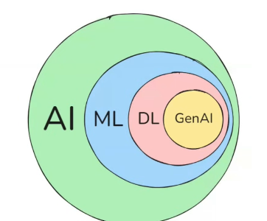

π
Neural Network
Neural network & History
Neural Network –How it works
Component of Neural network
Activation Function
Backward error propagation
Time Series Data
ANN,CNN,RNN
ANN
Neural Network-Layman term
RNN
Type of RNN
Problem with RNN
LSTM
Notes:
Content: https://www.linkedin.com/pulse/chunking-strategies-ai-data-kash-kashyap-0lghe/

Slide 2
1
2
3
Gradient Descent
Loss /Cost Function
Time Series
Relu
TanH
Vanishing Gradient Problem
Learning Rate
Sigmoid
feed forward NN

Slide 3
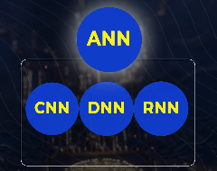
π
Neural Network
ANN are foundation of all neural network
CNN,DNN,RNN are special type of ANNs
Artificial Neural Network
Deep Neural Network
Convolutional neural network
Recurrent Neural Network
Auto encoder
Generative Adversarial Networks
GANs
Transformers
Notes:
Content: https://www.linkedin.com/pulse/chunking-strategies-ai-data-kash-kashyap-0lghe/

Slide 4
NLP History
2014
2015
2017
2018
RNN
Recurrent neural Net
transformer
GPT
LLM
Bert
Attention
mechanism
Google
Notes:
Content: https://www.linkedin.com/pulse/chunking-strategies-ai-data-kash-kashyap-0lghe/

